Slide 1

Maintaining Connectivity and Community
Segal Au
Julian Cheung
I want to learn about product management!
Angus Lei
TEAM NOOK
Leon Trieu
Sophia Wang
Notes:
Thanks judges and organizors

Slide 2
HACK-ATHON 2020
Overview
Problem
CHADDER
A Slack-based chat bot for new interns; answering onboarding questions and connecting them with expert employees.
Persona
Solution
Scalability
Back-end: Python
Front-end: Slack Bot API
Natural Language Processing: Google Cloud Dialogflow API
Summary
02/10

Slide 3
HACK-ATHON 2020
Overview
Problem
Persona
FRAMING THE PROBLEM
Solution
How might we promote a sense of community and connection for incoming interns working remotely?
Scalability
Summary
03/10

Slide 4
Persona - Isabelle
HACK-ATHON 2020
Overview
USE CASE
Problem
Isabella is a new intern who is starting her role remotely. This is her first time working on a distributed team.
Persona
Motivations
Needs
Solution
To be part of a
greater community
Efficiently find and organize new hire information
Feel confident finding learning materials and resources
A means to find and connect with experts throughout SAP
Scalability
To network and connect with professional talent
Complete her onboarding tasks
Summary
04/10

Slide 5
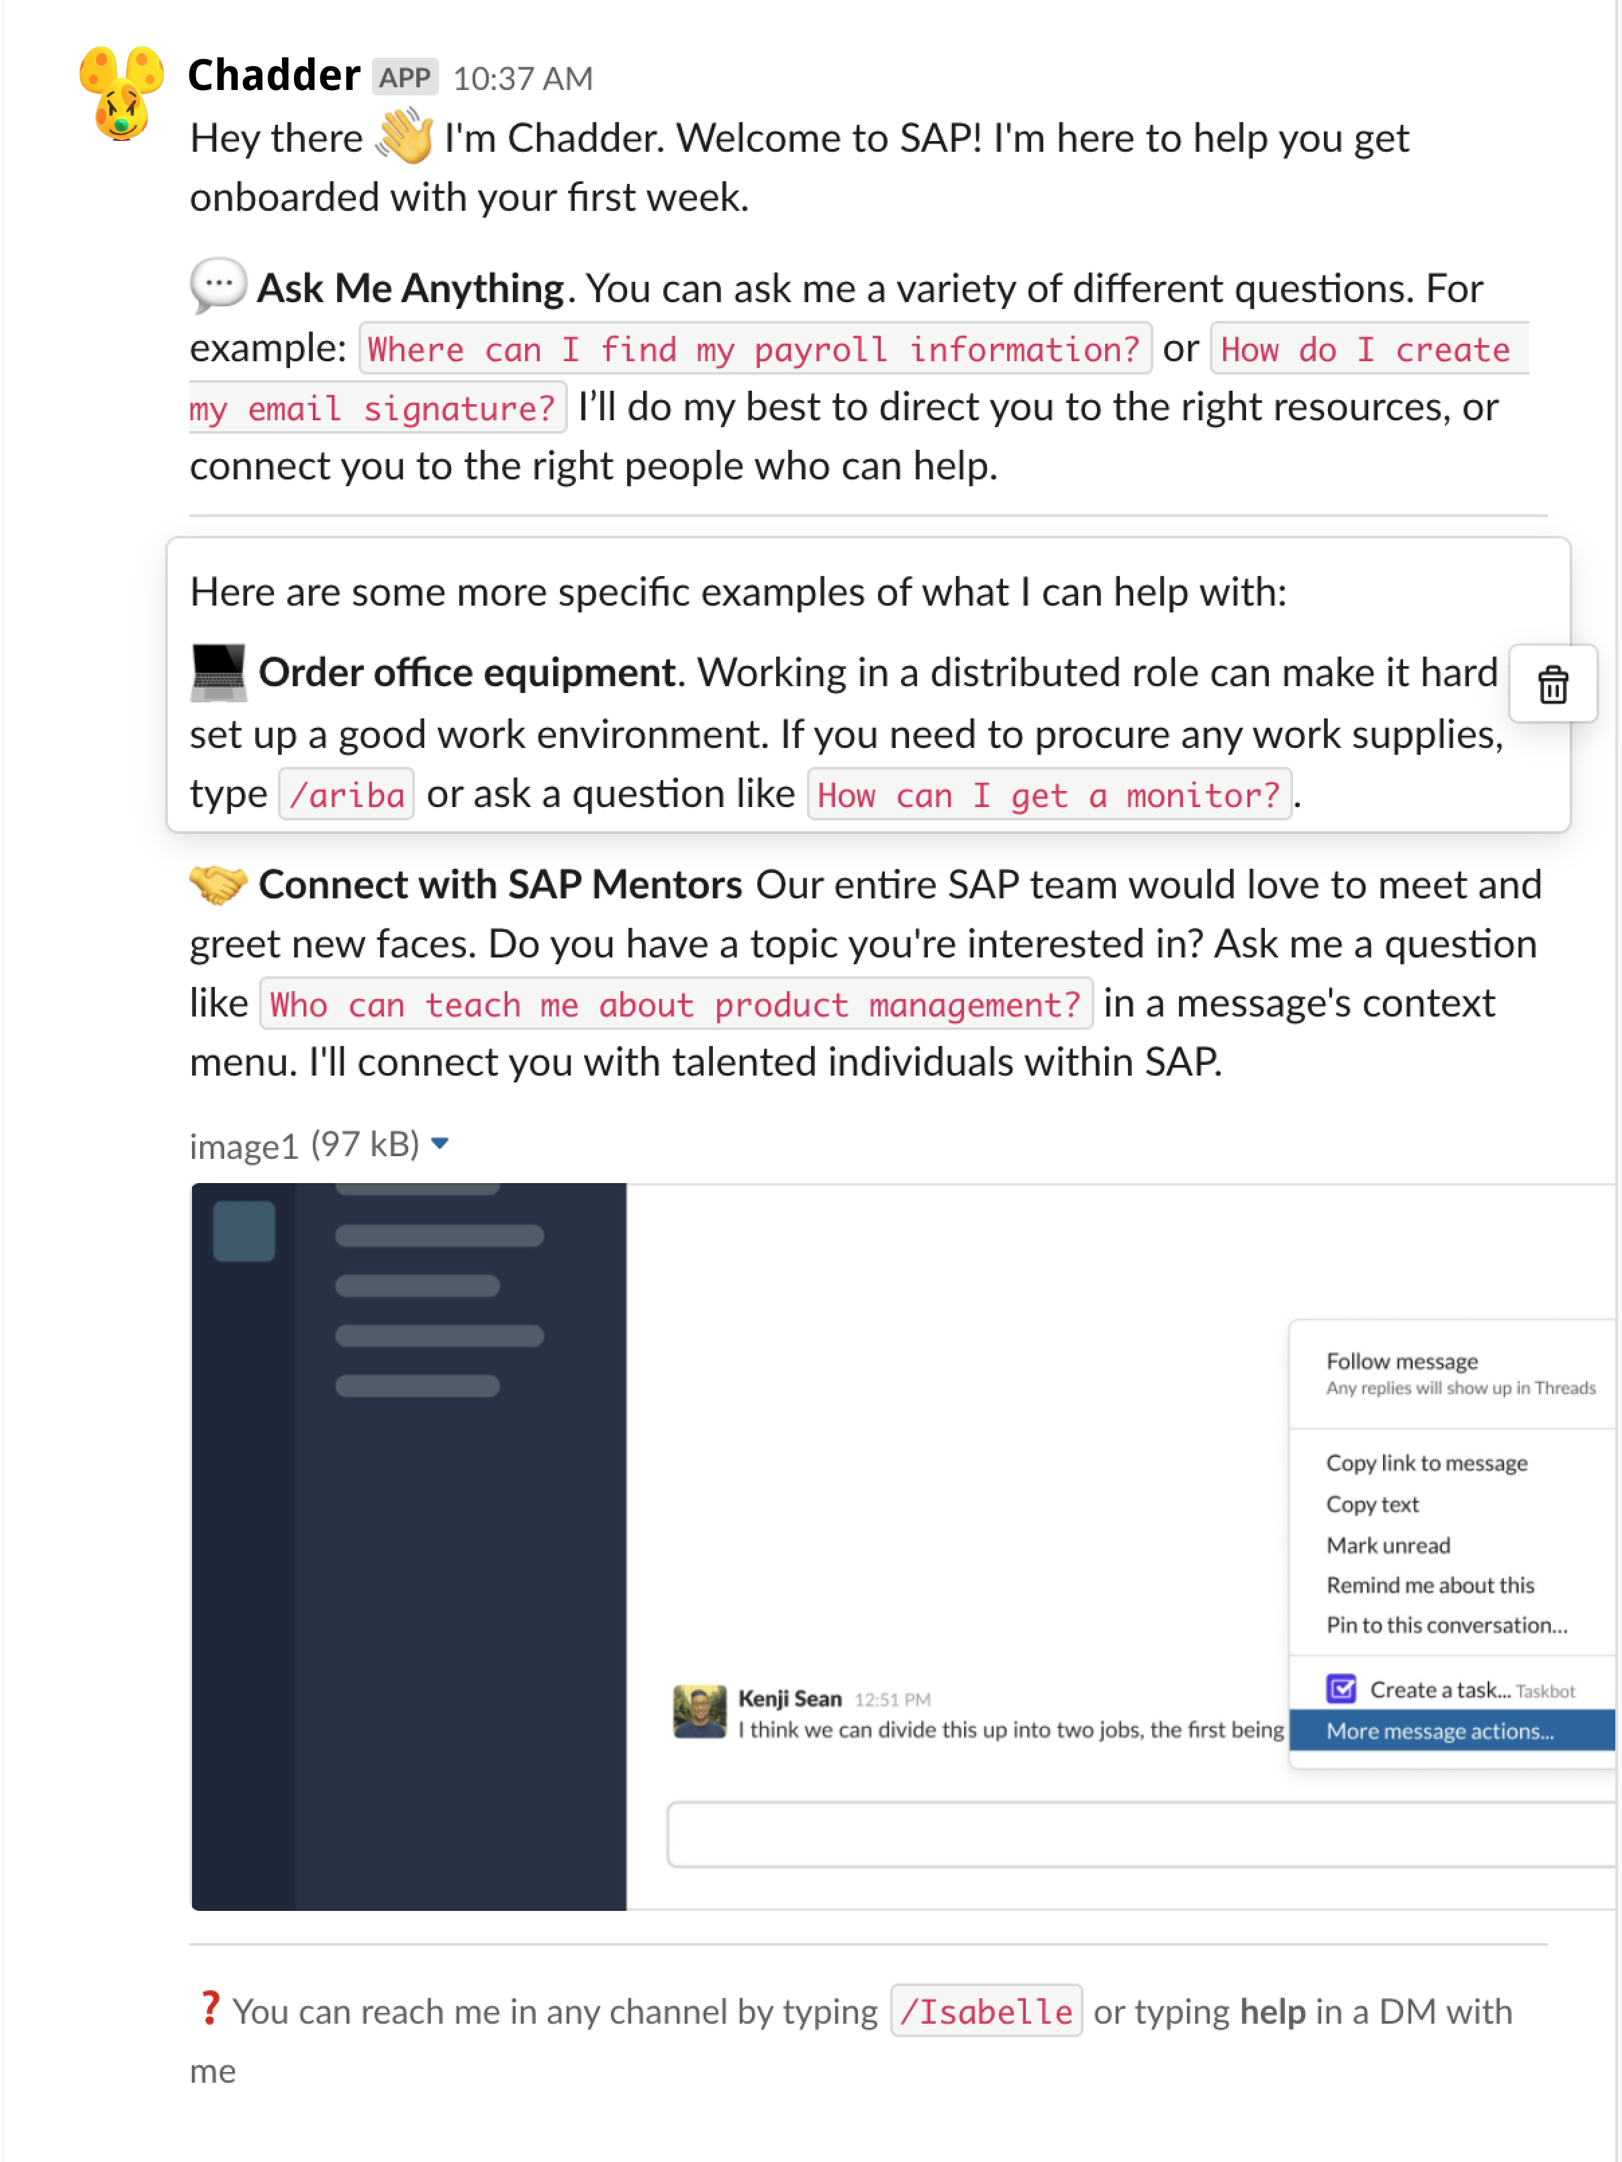
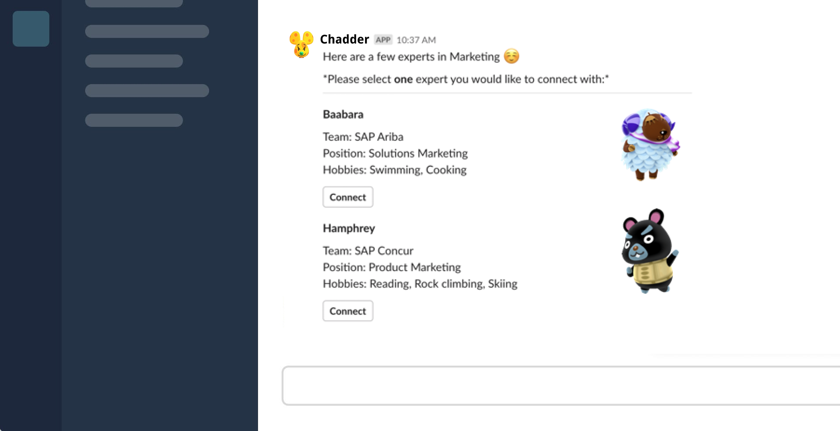
HACK-ATHON 2020
Overview
Problem
GETTING STARTED
Meeting Chadder
Persona
New interns are greeted by Chadder
and introduced to their functionality,
with suggested examples.
Solution
Back-end: Python
Front-end: Slack Bot API
Natural Language Processing: Dialogflow API
Scalability
Summary
05/10

Slide 6
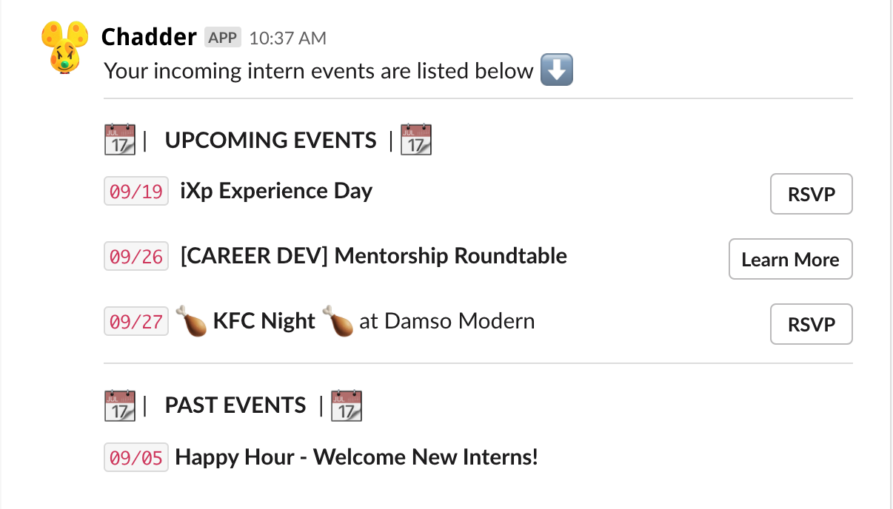
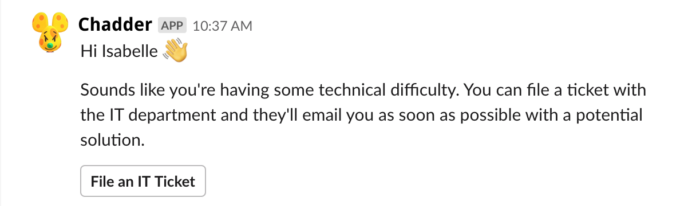
Broader Application
HACK-ATHON 2020
Overview
GENERAL FEATURES
Problem
Persona
LINKING TO CORPORATE PORTAL
Solution
Scalability
UPCOMING EVENTS
REDIRECTING TO INTERNAL TOOLS
Summary
06/10

Slide 7
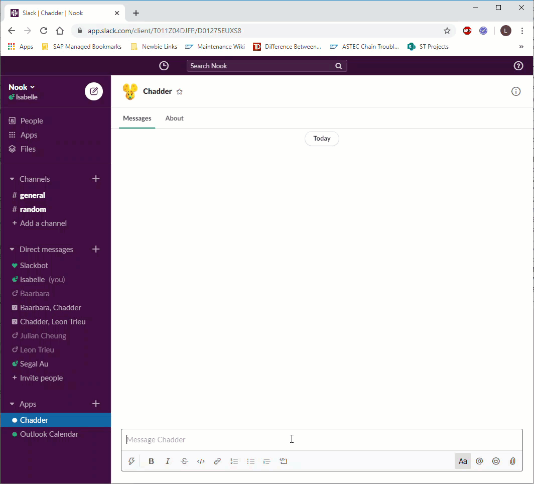

SCENARIO 01
HACK-ATHON 2020
Overview
Office Equipment Inquiry
Problem
Persona
Solution
Scalability
Summary
07/10

Slide 8
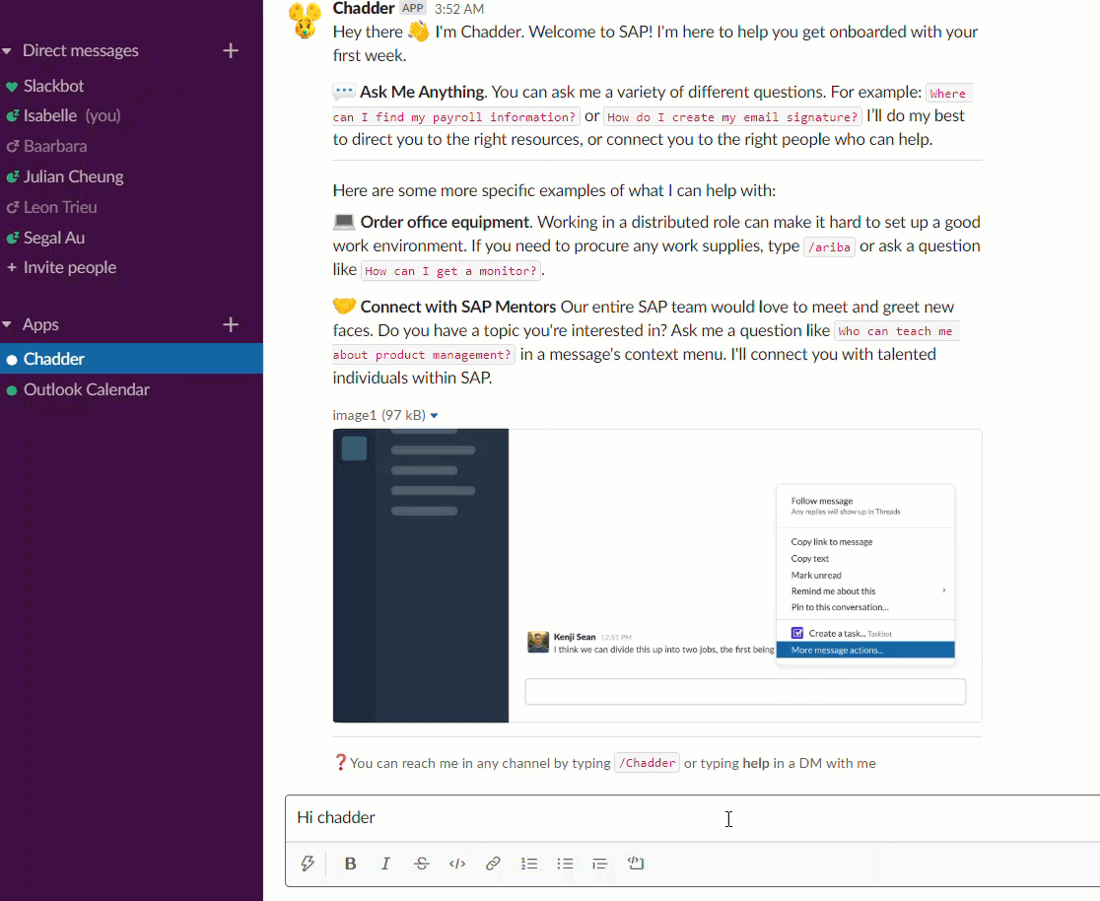
SCENARIO 02
HACK-ATHON 2020
Overview
Problem
Persona
Connecting
a Coffee Chat
Solution
Scalability
Summary
08/10

Slide 9
HACK-ATHON 2020
Overview
01
Beyond COVID-19
Problem
Persona
02
SAP Integration
Solution
SCALABILITY
03
Long Term Implementation
Global application
Scalability
Summary
09/10

Slide 10
HACK-ATHON 2020
Overview
Problem
Persona
SUMMARY
With Chadder, new interns like Isabelle can integrate and connect with SAP and begin building a bond with the community, in one centralized location.
Solution
Scalability
Summary
10/10

Slide 11
Thank you!

Slide 12
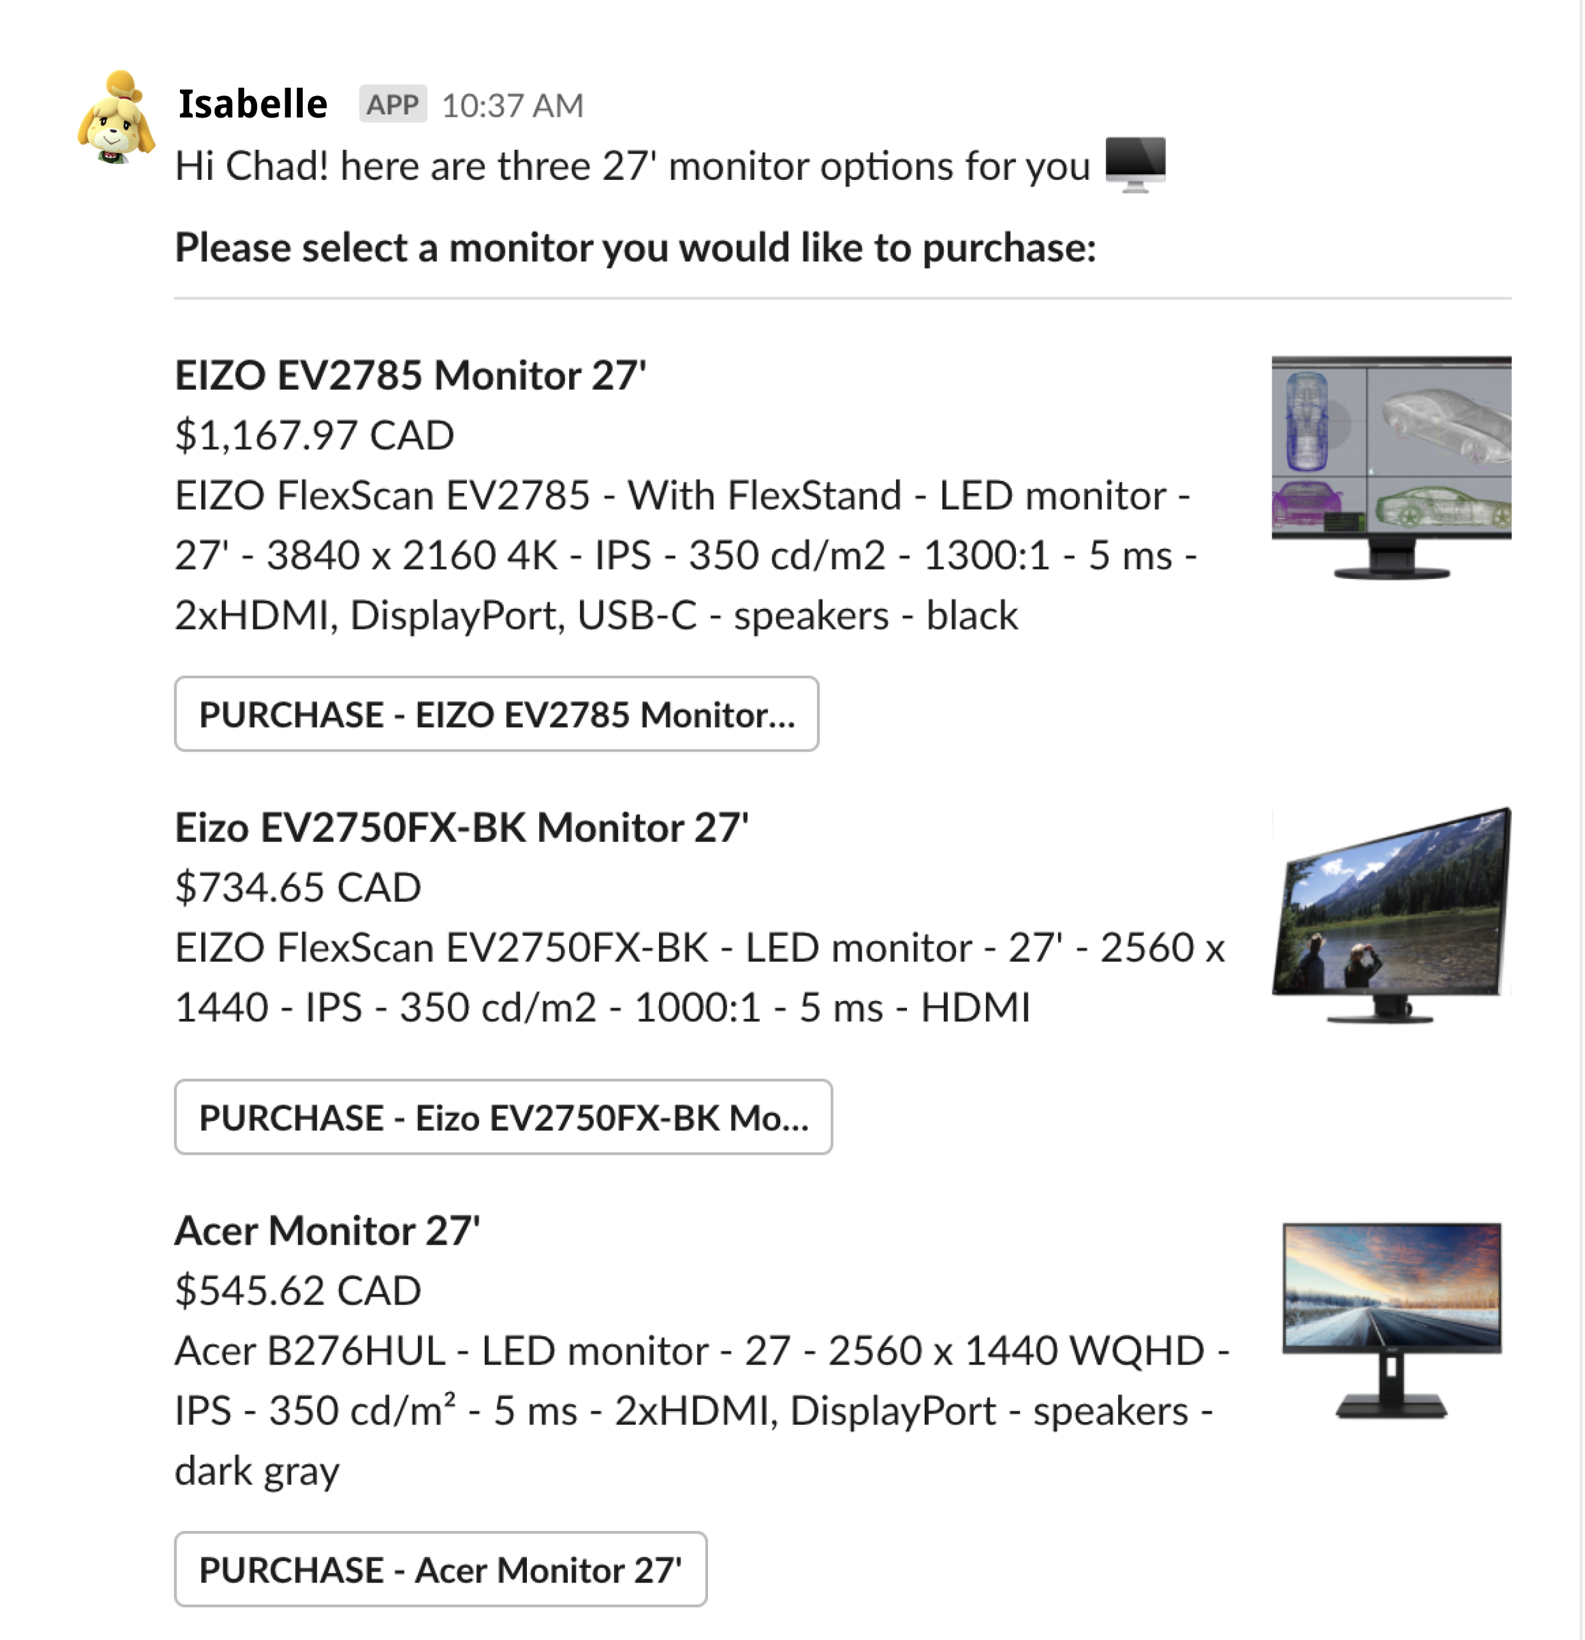
SCENARIO 01
HACK-ATHON 2020
Overview
Problem
Persona
Solution
Office Equipment Inquiry
Scalability
Summary
07/10

Slide 13
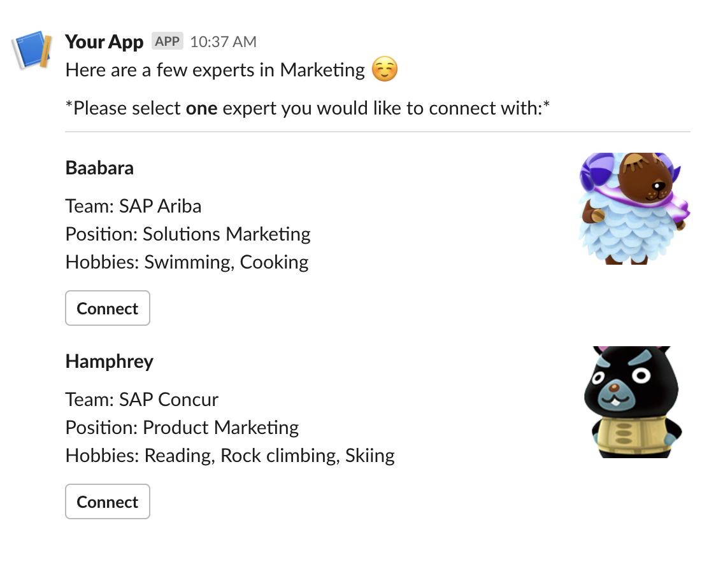


SCENARIO 02
HACK-ATHON 2020
Overview
Problem
Persona
Connecting
a Coffee Chat
Solution
Scalability
Summary
08/10
Notes:
Leon
solution

